Slide 1

Optimal Placement of Electric Vehicle Charging Stations
Hari Srinivasan A R – 224003031
Akshaya Rohith M – 224003008
Hariharan Subramanian – 224003032

Slide 2
Problem Statement
Electric vehicles is a fast penetrating transport for any country. Presence of a resilient and convenient EV charging infrastructure is a major pre-cursor for prospective EV buyers
Optimal placement of EV charging stations are dependent on many factors and objectives like: average distance of a random user to a nearby station, no. of a charging stations in a area, no. of charging ports in a charging station, demand for charging in a area etc…
Our aim, is to incorporate some of these objectives in our optimization model, solve it using evolutionary computing tools and get the optimal placement of coordinates such that the cost is minimized.

Slide 3
Problem Formulation
Objectives
Constraints
Potential Solution Obtained
We shall tackle investment and operating cost as the 1st objective, along with the distance to charging station objective as the 2nd one.
We are not considering daily demands, and real world datasets have not yet been incorporated
At the end, a cost-optimized with overall travel distance minimized solution shall be obtained

Slide 4
Overall Layout of the Project
Generate Intersections and Geometric Centers
Choose an Evolutionary Computing Algorithm
Randomly Initialize a population for that EC algorithm
Decide and Calculate F1, and F2 objectives
Perform the EC Algorithm steps for n no of iterations and run until termination criteria met
Generate Random demands at demand points
Best solution obtained in n iterations is the solution
To calculate objective->calculate service area of charging station->Use Voronoi Diagram as service area

Slide 5
Randomly Initialize the Population
Feed the Population as “INPUT” to the EC Algorithm
Calculate the objective, update the population, and terminate the algorithm until termination criteria is met
FINAL OPTIMAL SOLUTION OBTAINED!!!

Slide 6
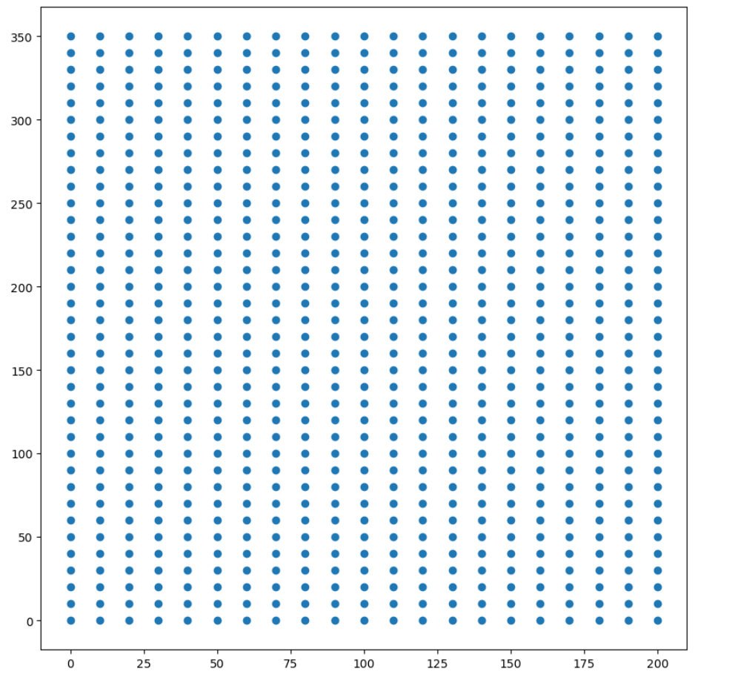
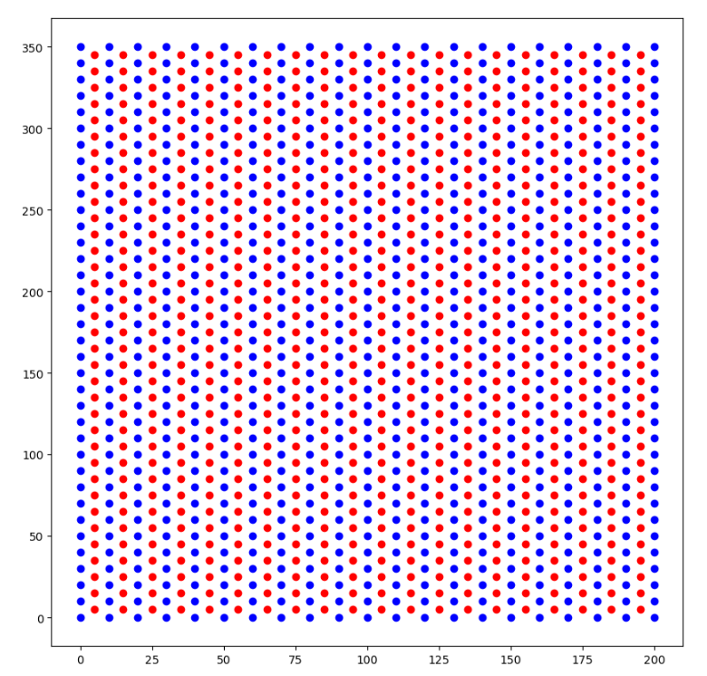
1. Generate Intersections and Geometric Centers
Parameters:
Max_X=200
Max_Y=350
Min_X=0
Min_Y=0
Split_Distance for each cell=10
In the end, (200*350)/(10*10)=700 cells generated->Hence 700 Geometric Centers Available
Blue->Intersection Points
Red->Geometric Centers
Intersection Points
Intersection points and Geometric Centers

Slide 7
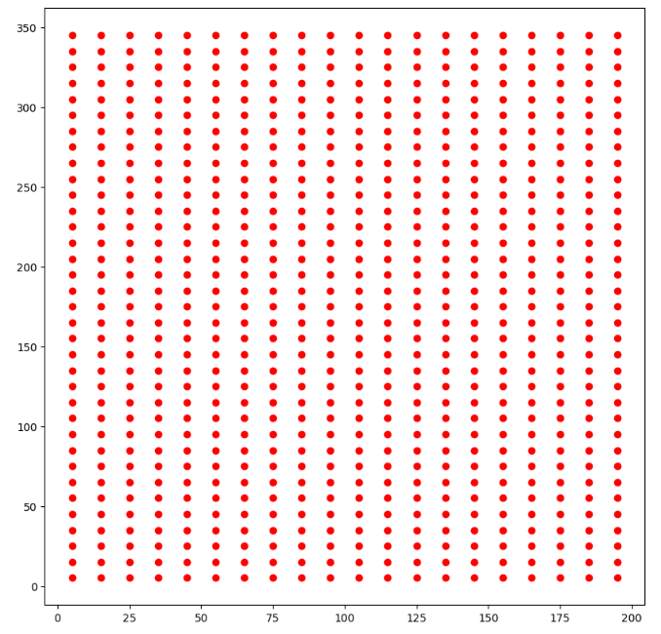
Now we shall do away with the Intersection points, From Now on our geometric centers shall be our demand points!!!
Do away with the intersection points

Slide 8
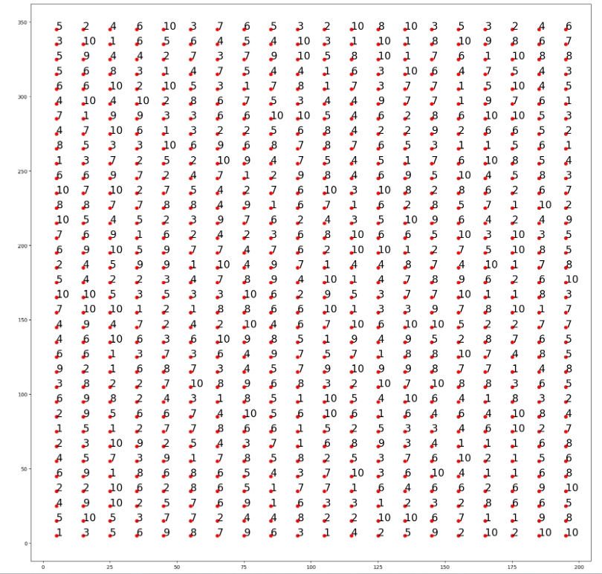
2. Generate Random demands at demand points
Random demands at the demand points
Parameters:
Demand(point)=A random integer between 1 and 10
Demand(point)=No of Vehicles that need charging at that demand point!

Slide 9
3. Choose an Evolutionary Computing Algorithm
Evolutionary Computing
Particle Swarm Optimization(PSO)
Genetic Algorithm(GA)

Slide 10
3a. Genetic Algorithm
Updation of Population
Crossover(Single Point)
Mutation
Selection(Tournament Selection)
For the First iteration, Initialize a random population and Feed into the GA Algorithm

Slide 11
3b. Particle Swarm Optimization
Particle Velocity calculation
New Particle Position Calculation
Update Global Best Solution
Update Particle Best Position
For the First iteration, Set the global best as a very high value
Initialize Particle Position randomly for 1st Iteration, Similarly The particle best position

Slide 12
For GA
New Population=Parent Population
New Population=Parent Population
Perform Crossover
Perform Crossover
Crossed Over Population
Crossed Over Population
Crossed Over Population
Crossed Over Population
Crossed Over Population
Crossed Over Population
Crossed Over Population
Crossed Over Population
Initialize a population
Initialize a population
Perform Mutation
Perform Mutation
Perform Mutation
Perform Mutation
Perform Mutation
Perform Mutation
Perform Mutation
Tournament Selection
Perform Mutation
Tournament Selection
Tournament Selection
Tournament Selection
Tournament Selection
Tournament Selection
Mutated-Crossed Over Parent Population=Aka CHILD POPULATION!
Mutated-Crossed Over Parent Population=Aka CHILD POPULATION!
Mutated-Crossed Over Parent Population=Aka CHILD POPULATION!
Mutated-Crossed Over Parent Population=Aka CHILD POPULATION!
Mutated-Crossed Over Parent Population=Aka CHILD POPULATION!
Mutated-Crossed Over Parent Population=Aka CHILD POPULATION!
Mutated-Crossed Over Parent Population=Aka CHILD POPULATION!
New Population
Mutated-Crossed Over Parent Population=Aka CHILD POPULATION!
New Population

Slide 13
4. Random Initialization of Population for the EC algorithm

Slide 14
For GA
A GA population consists of 10 members
Each member consists of Nc no. of coordinates
Each coordinate is an (x,y) tuple

Slide 15
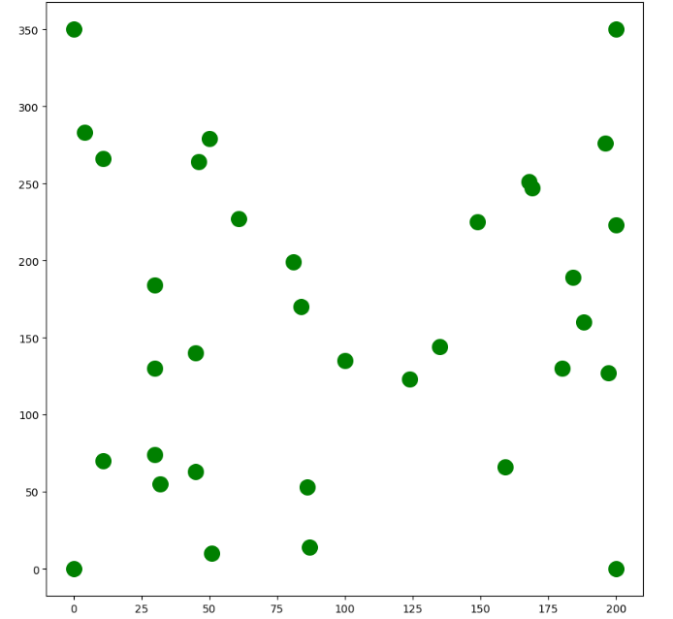
What does population initialization mean? How does a population look like??
GA Population Format
Member 1
Initialized Population
Member 2
Member 3
Member 4
Member 5
Member Format
Member 6
Updated Population
Member 7
Member 8
Member 9
Member 10

Slide 16
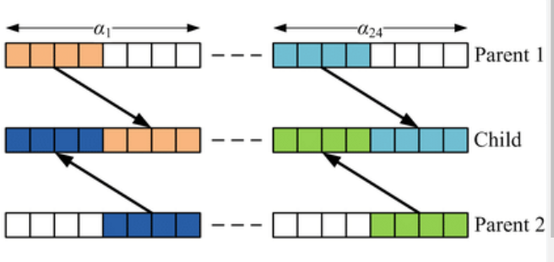
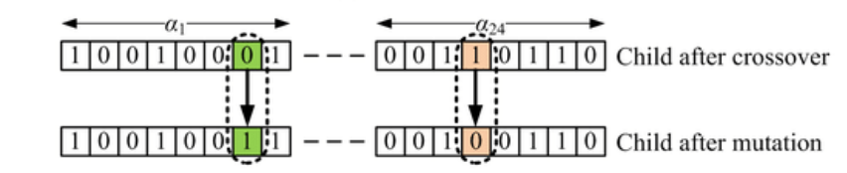
Crossover and Mutation
Perform Crossover
Perform Mutation
Perform Selection

Slide 17
Single Point Crossover
Ci,1(x,y)
Ci,2(x,y)
Ci,3(x,y)
Ci,4(x,y)
Ci,15(x,y)
Ci,16(x,y)
Ci,29(x,y)
Ci,30(x,y)
…………………………………………………………………………………………………………….
Cj,1(x,y)
Cj,2(x,y)
Cj,3(x,y)
Cj,4(x,y)
Cj,15(x,y)
Cj,16(x,y)
Cj,29(x,y)
Cj,30(x,y)
…………………………………………………………………………………………………………….
Cj,1(x,y)
Cj,2(x,y)
Cj,3(x,y)
Cj,4(x,y)
Cj,15(x,y)
Ci,16(x,y)
Ci,29(x,y)
Ci,30(x,y)
…………………………………………………………………………………………………………….
Ci,1(x,y)
Ci,2(x,y)
Ci,3(x,y)
Ci,4(x,y)
Ci,15(x,y)
Cj,16(x,y)
Cj,29(x,y)
Cj,30(x,y)
…………………………………………………………………………………………………………….

Slide 18
Selection
Parent Population
Child Population
Member 1
Member 1
Member 2
Member 2
Randomly select 2 members from parent population, and 2 ,members from child population
Member 10
Member 10
Compare with the 4 members and select the member that is the lowest value(Tournament Selection)
Put that member into the new population
Loop until the new population is filled with 10 members

Slide 19
For PSO
Our Swarm consists of 20 particles
Each particle consists of Nc no. of coordinates
Each coordinate is an (x,y) tuple

Slide 20
What does Swarm initialization mean? How does a Swarm look like??
PSO Swarm Format
Particle 1
Initialized Swarm of Particles
Particle 2
Particle 3
Particle 4
.
.
.
.
.
Particle Format
After Every Iteration
Particle 18
Updated Swarm of Particles
Particle 19
Particle 20

Slide 21
GLOBAL_BEST
PARTICLE_BEST
value
position
Iteration number
value
position
Iteration number
IN EACH ITERATION (i):
PARTICLE_(1)_BEST
PARTICLE_(2)_BEST
PARTICLE_(20)_BEST
………………
Update if f(pi) < existing f(pbest) else keep the same existing pbest
AFTER EACH ITERATION :
GLOBAL_BEST
Update if f(pbest) < f(gbest) else keep the same gbest

Slide 22
VELOCITY CALCULATION
The Velocity is calculated For Each co-ordinates in each particle , using the below formula
Particle 1
Particle 2
Particle 3
Particle 4
Particle 20
……………………
(x1,y1) , (x2,y2) , (x3,y3) , (x4,y4) , (x5,y5) …………………………………………………………………………….(x_{nc} ,y_{nc})
Iteration 1
Iteration 2
( x1 , y1 )
(x1_{new} , y1_{new})
(( x1 + V_{i}),( y1 + V_{i}))

Slide 23
Difference between
Pbest and particle’s current position
Difference between Gbest and particle’s current position
Old Velocity
Social coefficient
Inertia weight
Particle coefficient
Acceleration Coefficient for cognitive coefficient
Acceleration coefficient for social coefficient

Slide 24
ULTIMATE SOLUTION
The Global Best Position after 100 Iterations
GLOBAL_BEST
value
position
Iteration number

Slide 25
5. Calculate F1, F2 Objectives

Slide 26
Feed the Member
Take a member of population(either PSO or GA). This member shall contain Nc (no. of charging station coordinates)
Generate Voronoi Diagram
Using the coordinates, generate the Voronoi Diagram
This diagram shall give the service area of each charging station
Get Demand per charging station
Once the service area is defined, the demand points to be serviced by that charging station is fixed
Hence, all the demands at the “to be serviced” demands for that charging station have to be met
Hence, the total demand for each charging station is found out this way
Get Chargers at each charging station
Based on the demand to be serviced by that charging station, the no. of chargers need to be computed. I.e a single charger can only serve a fixed no. of vehicles in a given time. Using a formula, the no. of chargers needed is computed.

Slide 27
Calculate F1 Objective
This objective deals with establishment cost. Charger cost, Operating cost, and penalty.
Calculate F2 Objective
This objective deals with distance cost and penalty
The distance between the demand point and the “assigned” charging station is calculated
Calculate Overall Objective
Overall Objective = F1+F2
Another penalty is applied here-> If the distance between any 2 charging stations is lesser than a threshold, then a penalty is applied
Establishment cost is a fixed no. = establishment cost*Nc
Charger cost=Procurement cost per charger
Operating cost=15% of Establishment cost
Penalty= It is only viable for a charging station to have chargers within a certain range(in our case b/w 3 and 10). If it goes below or above this range a penalty is applied
Then, the travel cost(in terms of the electricity cost paid to charge the vehicle in order to travel the distance) is used as the “DISTANCE COST METRIC”
A penalty is applied if the distance itself is greater than a maximum threshold
This is to discourage the algorithm from placing charging stations too close to each other

Slide 28
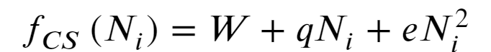
Objective Value=F1+F2
F1=Establishment and Operating Cost
F2=Distance Cost
i-index to refer to charging station
A-amt of electricity consumed by the EV to travel 1km
Fcs-Establishment cost+Charger Cost+Penalty
Jcs-Set of Charging stations
P-charging price of EV per km
i-index to refer to charging station
J-index for referring to demand point j
Ucs-Operating Cost
Ni-No of chargers in charging station i
Jcs-Set of Charging stations
Jcni-Set of all demand points serviced by charging station i
Charger qty penalty(F1 Penalty)
Dij-distance between charging station I and demand point j
W-Establishment cost of charging station
Min no of chargers to be placed at station i
nj-no of vehicles that require charging at demand point j, or in other words demand of demand point j
e-auxiliary investment coefficient
Max no of chargers to be placed at station i
Ni-No of chargers at charging station i
q-price of charger

Slide 29
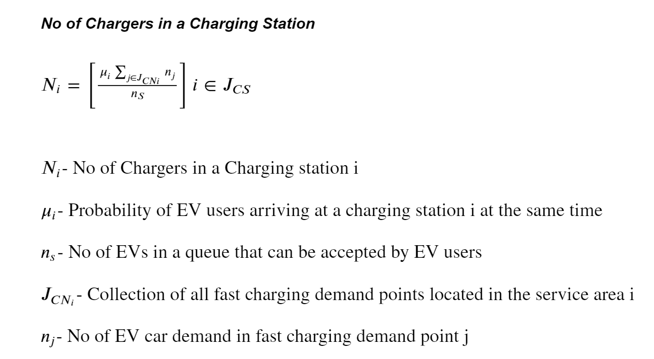

Slide 30
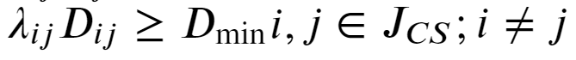
dmax-max threshold distance for consumer travel for charging
F2 Penalty-Distance Threshold Penalty
Overall Penalty-Distance b/w charging stations
Lambdaij-Road gradient coefficient
Dij-Distance between any 2 charging stations i&j
dij-distrance between charging station I and demand point j
For each charging station I in charging station set Jcs
Dmin-Minimum distance above which the distance should be, else penalty applied
For each demand point j that lies in service area of charging station i(Cni)

Slide 31
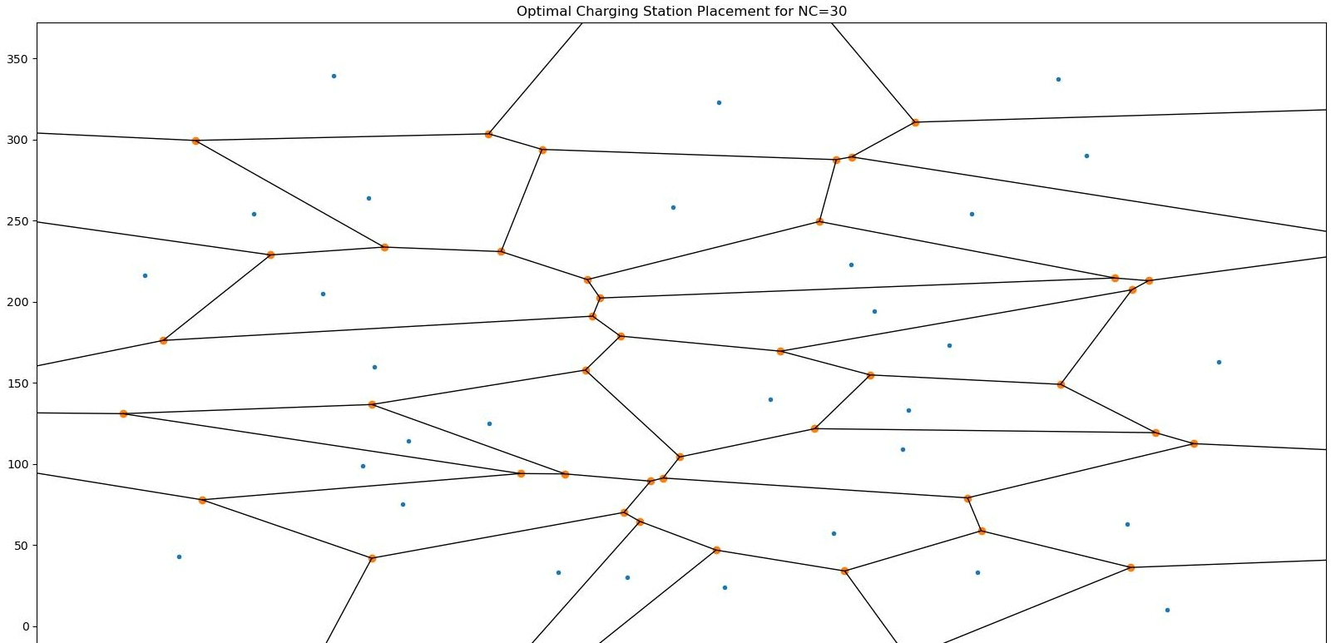
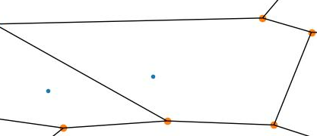
Generate Voronoi Diagram and get service area of each charging station
Sample service area of a charging station

Slide 32
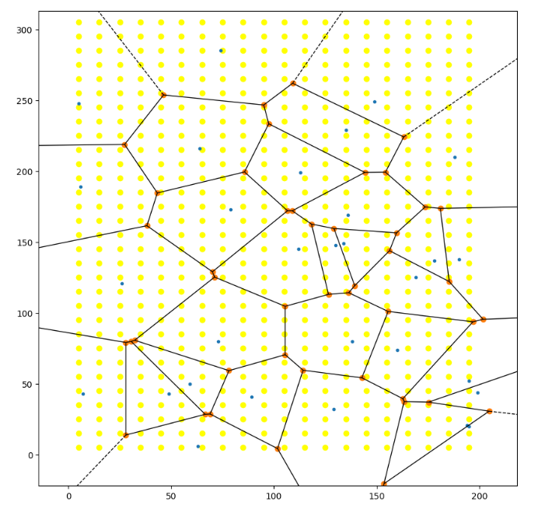
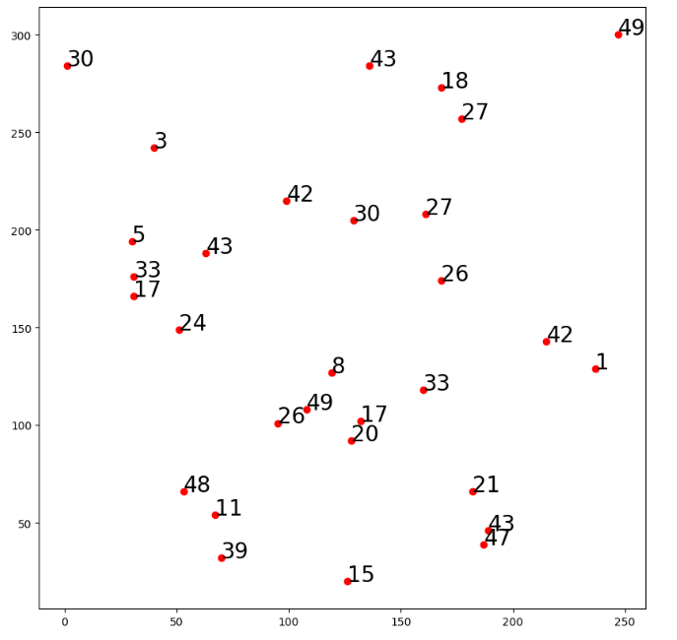
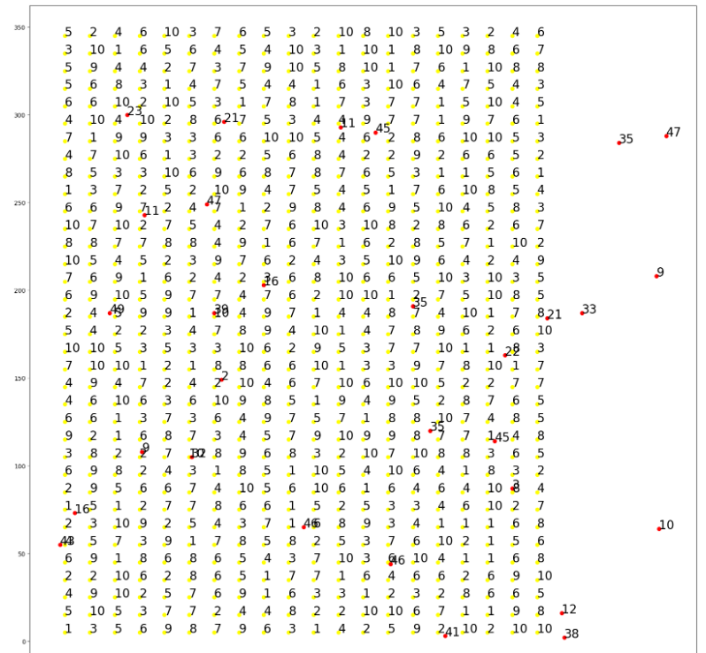
From service area, get the total demand to be serviced by each charging station
Proceed with the objective value calculation!!!

Slide 33
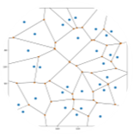
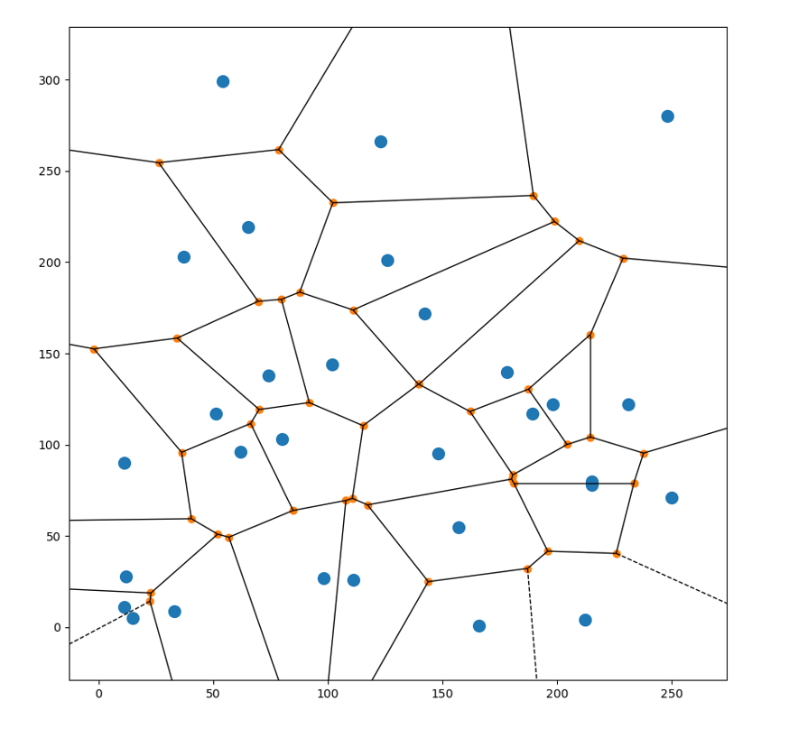
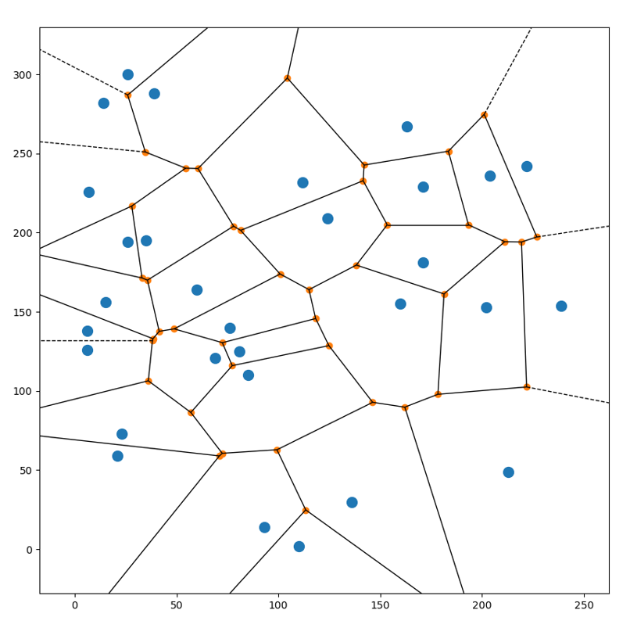
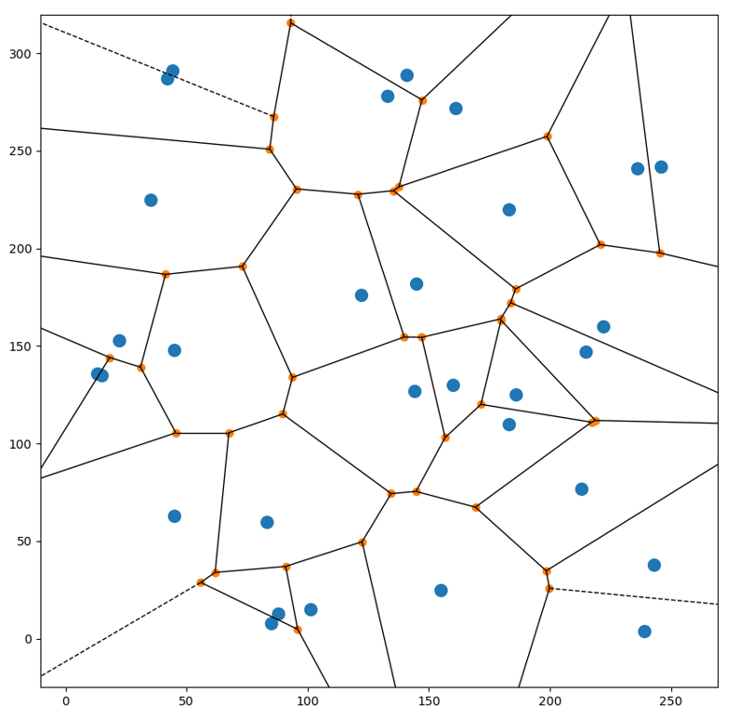
General Working of any EC algorithm
Iteration 2
Iteration 3
Iteration 4
Iteration 1
Iteration 100

Slide 34
Output

Slide 35
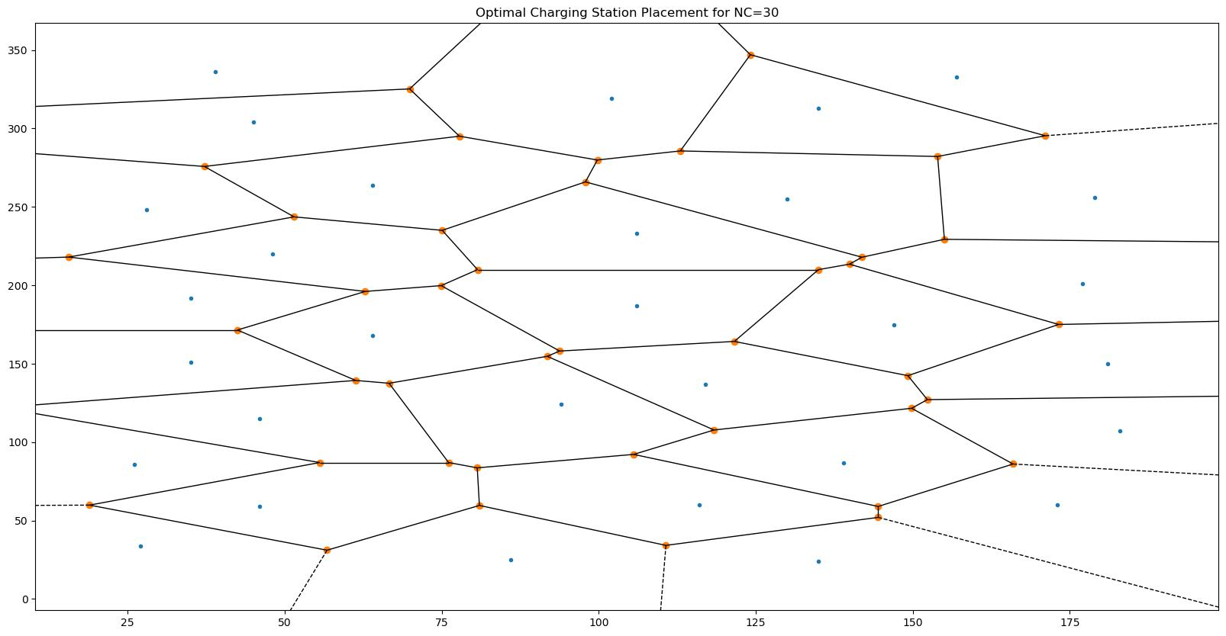
Feed Demand point coordinates and their respective demands
Final Output
Optimal Charging Station Coordinates
Associated Voronoi Diagram and Service Areas
Evolutionary Computing Algorithm

Slide 36
Results

Slide 37
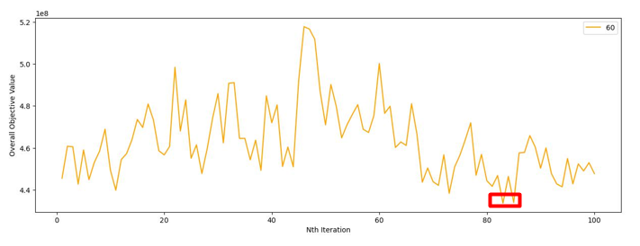
Sample Progression of Overall Objective Value(GA), Nc=60
Objective value reached at around 83rd Generation

Slide 38
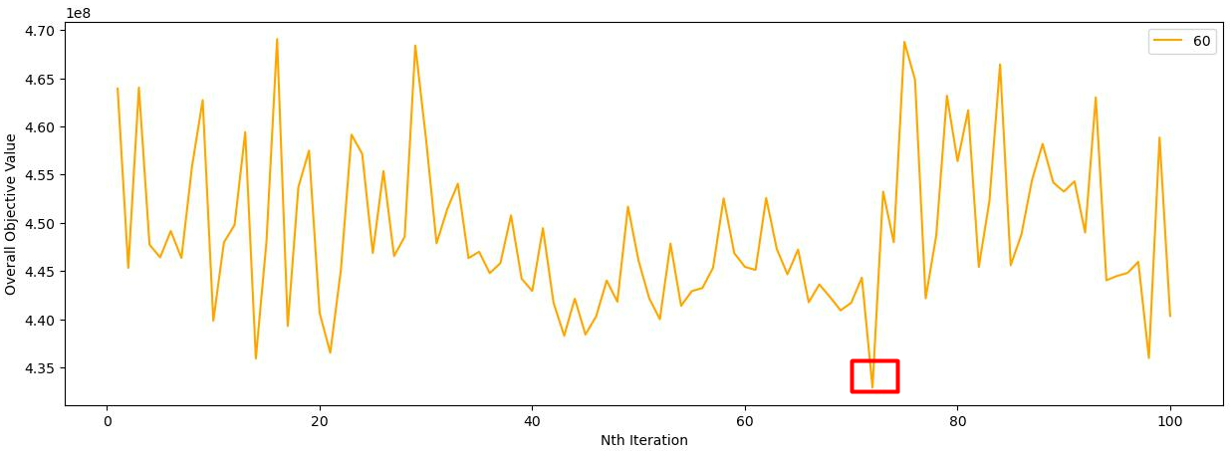
Sample Progression of Overall Objective Value(PSO), Nc=60
Objective value reached at 72nd Generation

Slide 39
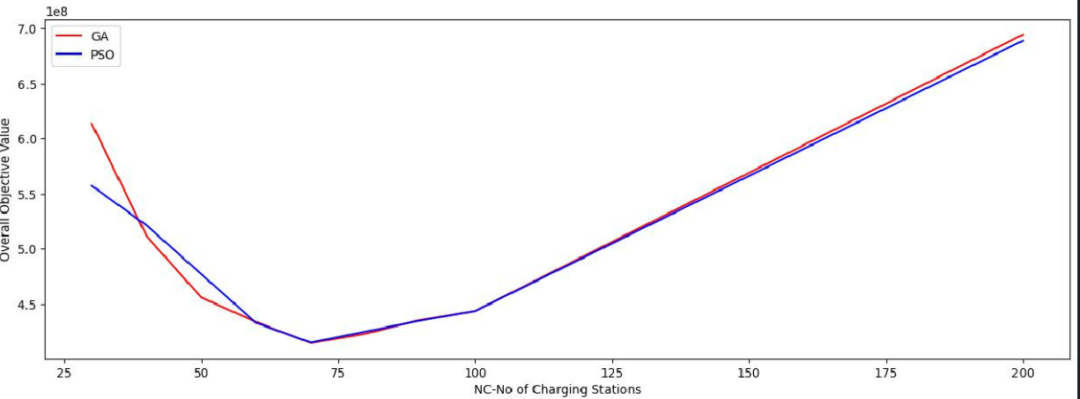
Comparison b/w GA and PSO, Overall Objective Value
Initially, PSO takes a higher value for Nc=30,40 and 50. From 60, onwards PSO takes a lower value

Slide 40
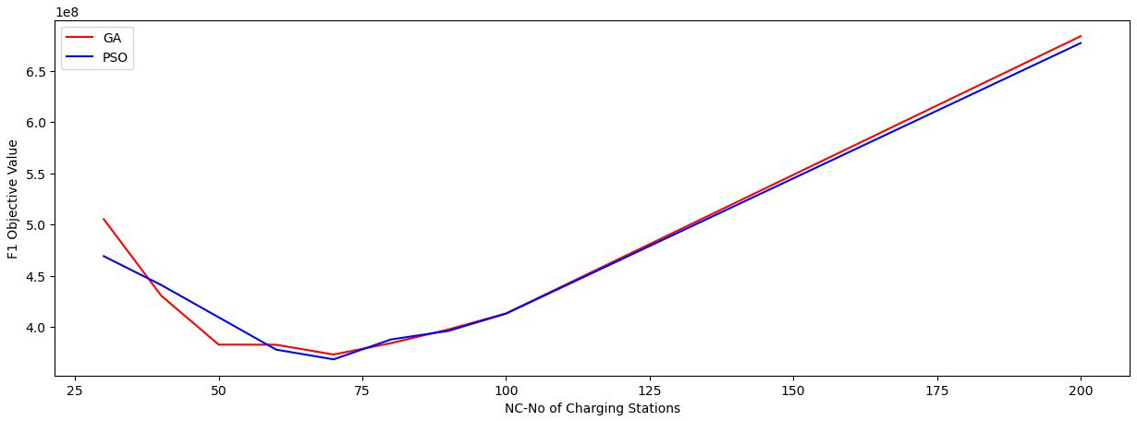
Comparison b/w GA and PSO, F1 Objective Value
Initially, PSO takes a higher value for Nc=30,40 and 50. From 60, onwards PSO takes a lower value, and GA starts taking a higher value
F1 objective value is very high initially, since many chargers need to be placed to satisfy the very high demand, as very less no. of charging stations are present
At the same time, when the no. of charging stations are very high, the no. of chargers in a charging station decreases(sometimes just 1 or 2 per station), hence again high penalty
Also, as the no. of charging stations increases, establishment cost increases(since more stations are built).

Slide 41
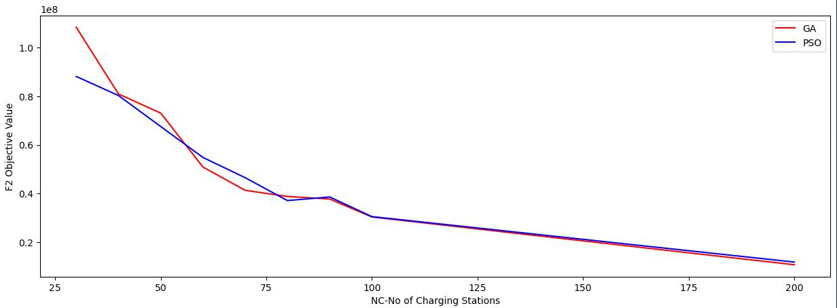
Comparison b/w GA and PSO, F2 Objective Value
Here, PSO and GA is behaving slightly differently in the start, but the usual behaviour starts to take form after Nc=100(i.e PSO takes the lower value)
The F2 objective value is strictly decreasing since, this objective value deals with distance.
Initially, since less no. of charging stations are present, more distance need to be travelled from Demand point to charging station. This shall incur more distance cost and penalty.

Slide 42
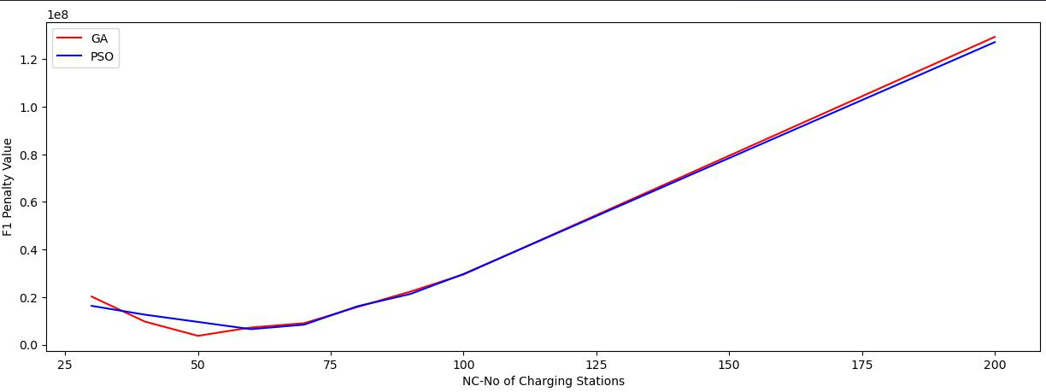
Comparison b/w GA and PSO, F1 Penalty Value
An increasing trend is observed with F1 penalty value w.r.t Nc since, as the no. of charging stations increases, the no. of chargers to be placed in a station decreases and hence the penalty value increases. The no.of chargers decreases, since the demand faced by each charging station decreases. Hence, the no.of chargers need not lie in the correct/non-penalty range.

Slide 43
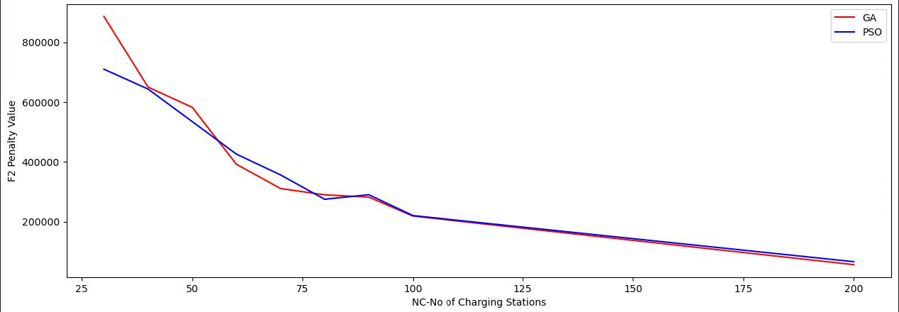
Comparison b/w GA and PSO, F2 Penalty Value
A decreasing trend is observed for F2 penalty value w.r.t Nc, since as the no. of charging stations increases, the distance b/w demand point and the assigned charging station decreases, and hence the distance should be well below the max-distance threshold.

Slide 44
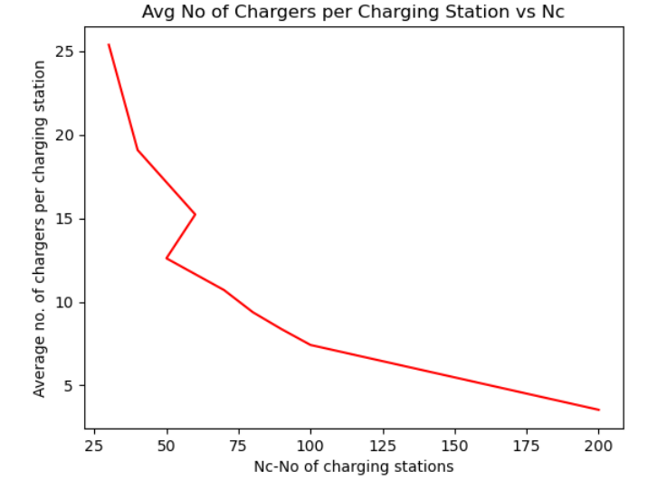
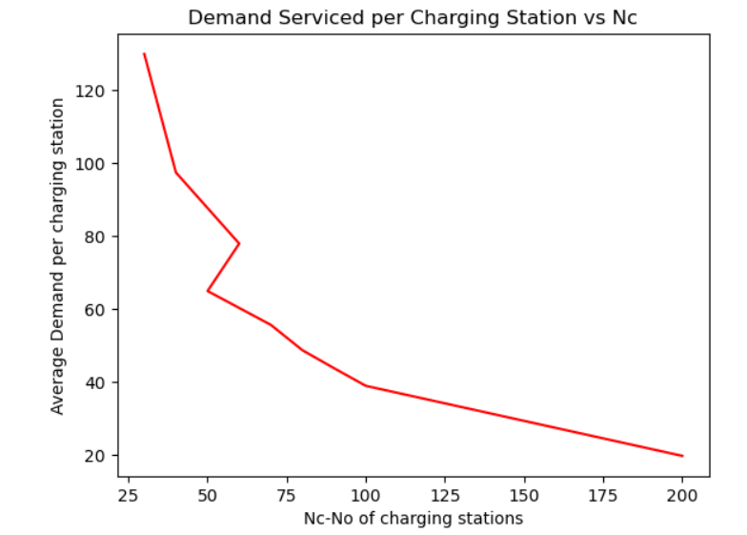
The above plots show that as the no. of charging stations increases, the avg demand serviced by that charging station as well as the avg no. of chargers placed in that charging station decreases.
This is due to the fact that the demand gets more evenly distributed as charging stations increases. Therefore lesser stress is placed on fewer charging stations(when Nc is less)

Slide 45
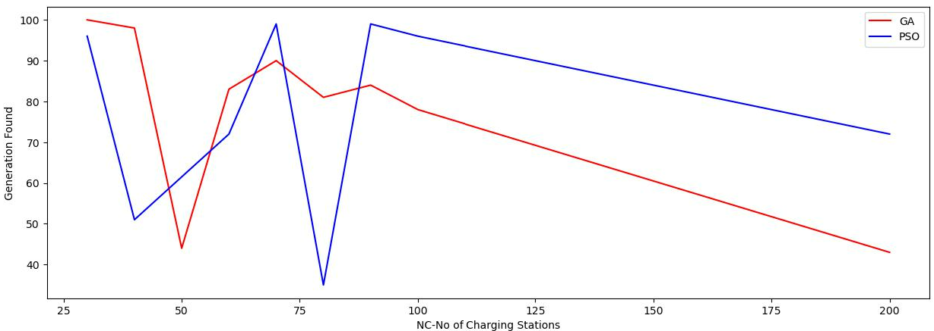
Comparison b/w GA and PSO, Generation Found
No specific trend is observed, however we observe that, that the optimal value need not occur at the 100th iteration, and can occur before that itself.

Slide 46
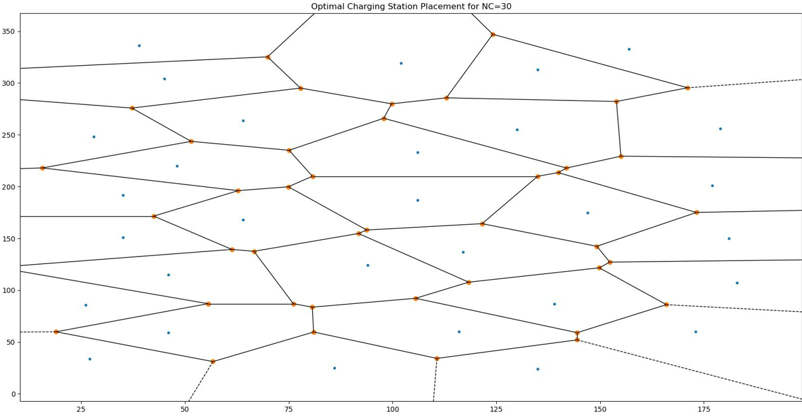
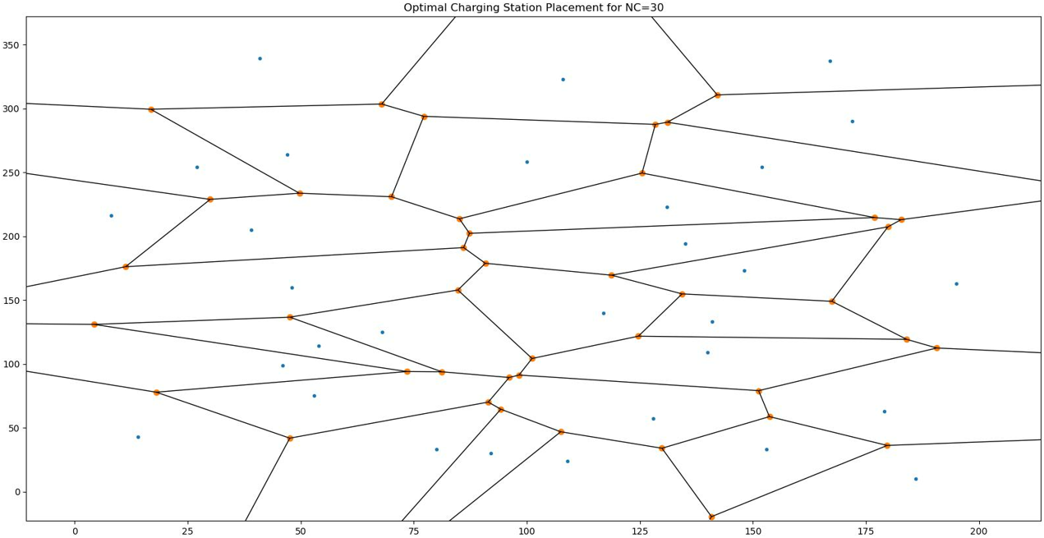
Sample Comparison b/w GA and PSO Voronoi Region for Nc=30

Slide 47
Final Results Table- GA
Nc | F1 Objective Value | F2 Objective Value | Overall Objective Value | F1 Penalty | F2 Penalty | Time Reqd | Generation -Optimal Found
30 | 505362000 | 108311600.00 | 613673600.00 | 20200000 | 886080.5039 | 9139.695562 | 100
40 | 430749500 | 80899950.00 | 511649400.00 | 9700000 | 649950.8123 | 9418.335084 | 98
50 | 382981500 | 73041420.00 | 456022900.00 | 3700000 | 582356.1404 | 10638.94923 | 44
60 | 382893500 | 50890010.00 | 433783500.00 | 7200000 | 392040.3119 | 11343.75235 | 83
70 | 373331500 | 41323730.00 | 414655200.00 | 9000000 | 310819.6625 | 6036.638057 | 90
80 | 384432500 | 38801590.00 | 423234100.00 | 15800000 | 289706.7234 | 6545.670928 | 81
90 | 397815250 | 37762950.00 | 435578200.00 | 22300000 | 282157.374 | 17098.7149 | 84
100 | 413410250 | 30366640.00 | 443776900.00 | 29500000 | 218763.5176 | 17838.21342 | 78
200 | 683774750 | 10753990.00 | 694528700.00 | 129400000 | 56339.80836 | 13040.7541 | 43

Slide 48
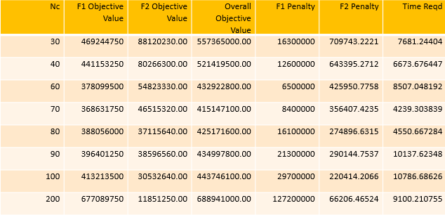
Final Results Table- PSO

Slide 49
Conclusion:
Two main results were obtained in this project:
For the given demand configuration , optimal value of N_{c} was found which was 70 in this case
For this value of N_{c} , the optimal configuration of co-ordinates was found for the placement of charging stations
In the future , we shall extend this to real world datasets and maps.

Slide 50
Thank You

